Slide 1
PRINCIPLES OF MEASURMENT SYSTEM AND SENSORS
21AIE114

Slide 2


BATCH-A GROUP-15
P.S.S.SAI KEERTHANA (CB.EN.U4AIE21038)
PASUMATHY KOMAL SAI ANURAG(CB.EN.U4AIE21039)
UDAYAGIRI VARUN(CB.EN.U4AIE21071)
SEJAL SINGH(CB.EN.U4AIE21061)

Slide 3
Smart Blind Stick using Aurdino UNO

Slide 4
Introduction

Slide 5
About Blind walking stick
Blind walking stick is also known as white cane is used by many people which are blind or visually impaired.
It allows its user to scan their surrounding and help them to navigate around easier.
Its another use is to analyze the person’s situation and take care of him all the time.
There are different types blind stick used by different persons based on their requirement.

Slide 6
Aim of the Project
In this project we are using Arduino UNO to add additional features to make the blind stick for the visually impaired more helpful.
The features we are trying add to the stick is UDS (Ultrasonic Distance Sensor) in all the possible direction for the user and alter him through a speaker, also we are including the LDR (Light dependent resistor) for detecting the amount of the light, moisture sensor to detect water in front of him, fire sensor to detect fire and finally the tilt sensor for the orientation of the stick.

Slide 7
Components and Tools required

Slide 8
Components :
S.No | Name of the Component | Quantity
1. | Arduino UNO R3 | 1
2. | Ultrasonic Distance sensor | 5
3. | Resistor | 5
4. | LED | 1
5. | Buzzer | 1
6. | Photoresistor | 1
7. | Tilt Sensor | 2
8. | Jumper wires | 1
9. | Speaker | 1
10 | Flame Sensor | 1
11. | Moisture sensor | 1

Slide 9
TINKERCAD CIRCUIT DIAGRAM

Slide 10
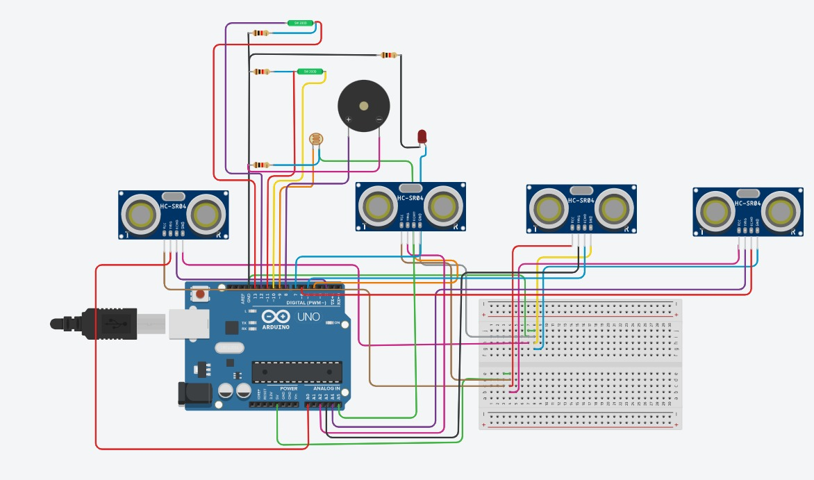

Slide 11
Working Logic

Slide 12
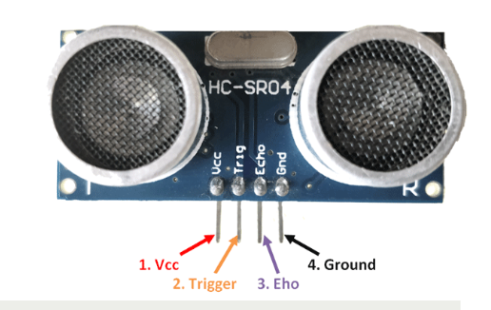
Ultrasonic Distance Sensor (UDS)
UDS is the popular sensor used in many application where measuring a distance or sensing a object is required. This module has two eyes in front which forms a transmitter and receiver.
They emit sound waves and wait for the sound waves to be reflected back and calculate distance based on the required time required.

Slide 13
Together 4 Ultrasonic sonic sensors in for different directions continuously scan the area infront of him that is in the effective range .
This information is feeded as an input to the Arduino. Here as we are using 4 Ultrasonic sensors, if it detect any object in its range the distance will be given to the Arduino.
The Arduino decides to notify the user by buzzing the buzzer in such a way that based upon the distance the buzzer will buzz at different frequencies and also alerts the user the saying ‘DANGER’.

Slide 14
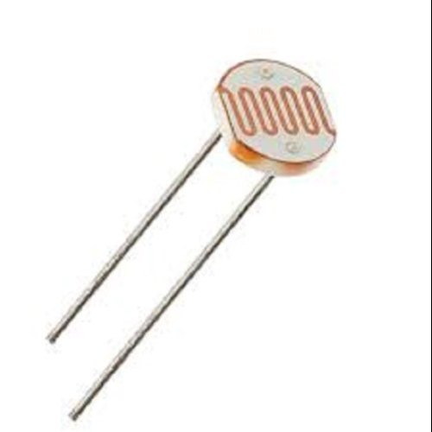
Light dependent Resistor (LDR)
LDR is photoconductivity, which is nothing but an optical phenomenon.
When the light is absorbed by the material then the conductivity of the material enhances.
When the light falls on the LDR, then the electrons in the valence band of the material are eager to jump to the conduction band.

Slide 15
The Light dependent Resistor(LDR) continuously scans the surrounding area for the quantity of the light.
During scanning the light if it found the intensity of light very low or very high. It passes the information to the Arduino.
Arduino reads that information and based upon that the buzzer buzzes for 1sec if the light intensity is low or high.

Slide 16
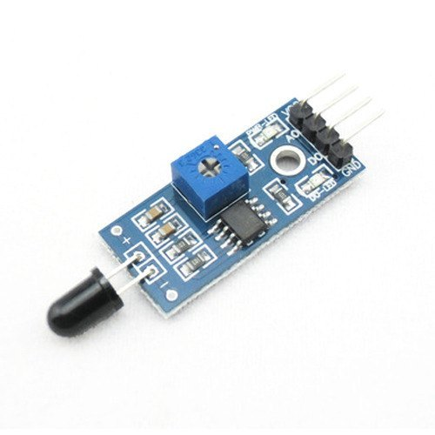
Flame Sensor
This sensor/detector can be built with an electronic circuit using a receiver like electromagnetic radiation.
This sensor uses the infrared flame flash method, which allows the sensor to work through a coating of oil, dust, water vapor, otherwise ice.

Slide 17
The flame sensor has a photodiode to detect the light and an op-amp to control the sensitivity.
When it detects fire, it will provide a high signal upon the detection. Arduino reads the signal and provides the alert by through the speakers saying “FIRE!!”.

Slide 18
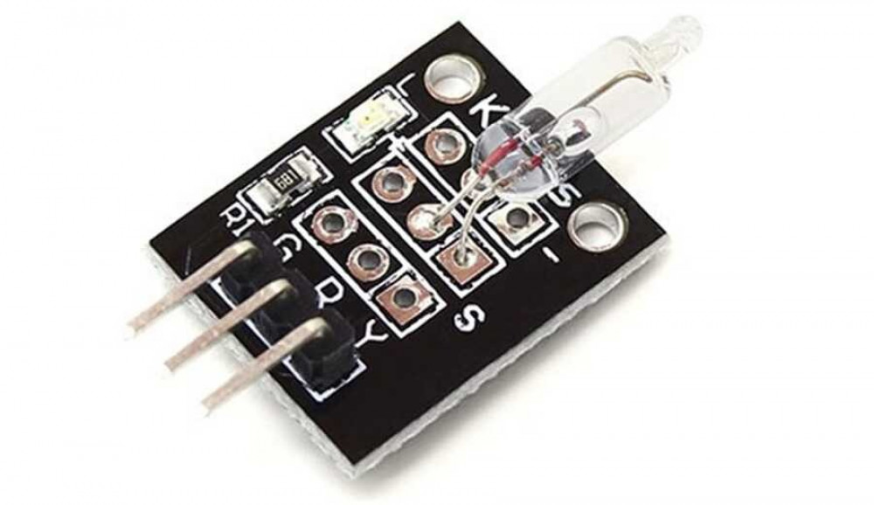
Tilt Sensor
A tilt sensor is an instrument that is used for measuring the tilt in multiple axes of a reference plane.
Tilt sensors measure the tilting position with reference to gravity and are used in numerous applications.
They enable the easy detection of orientation or inclination.
When the cane tilts more than a certain amount, the Arduino notifies the user's caregivers via the LED for 1s until he has recovered.

Slide 19
Here in the stick we use the tilt sensor to see whether there is a change in the angle of the stick
So, whenever the angle of the stick changes the mercury in the module tilts and the LED on it glows.

Slide 20
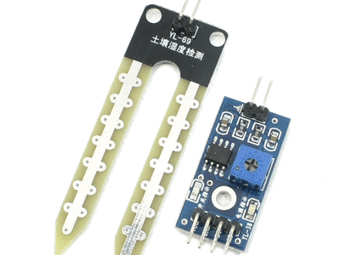
Moisture Sensor
Moisture sensors measure the water content in the soil and can be used to estimate the amount of stored water in the soil horizon.
Soil moisture sensors do not measure water in the soil directly. Instead, they measure changes in some other soil property that is related to water content in a predictable way.
In this blind stick, the moisture sensor detects if water is contact with it and feed the information to the Arduino. It reads the information and alter user by saying ‘ALERT’ through the speaker.

Slide 21
CODE

Slide 22
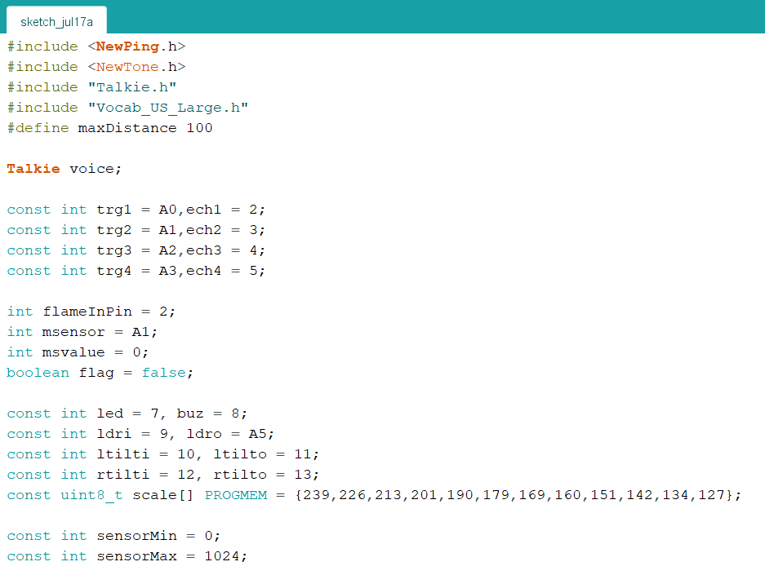

Slide 23
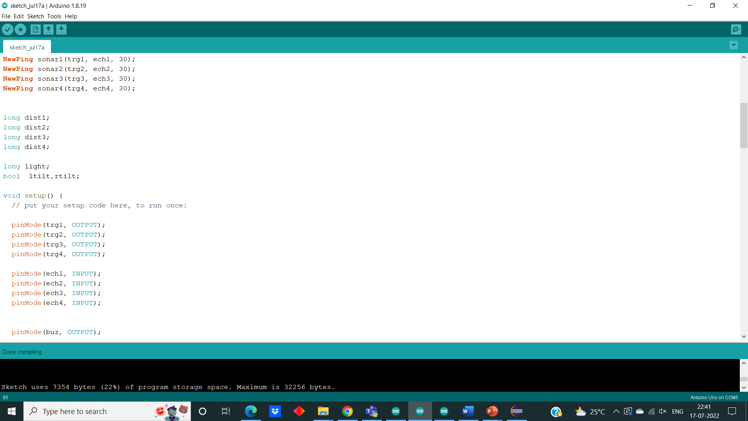
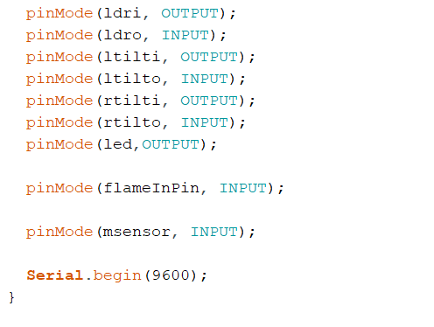

Slide 24
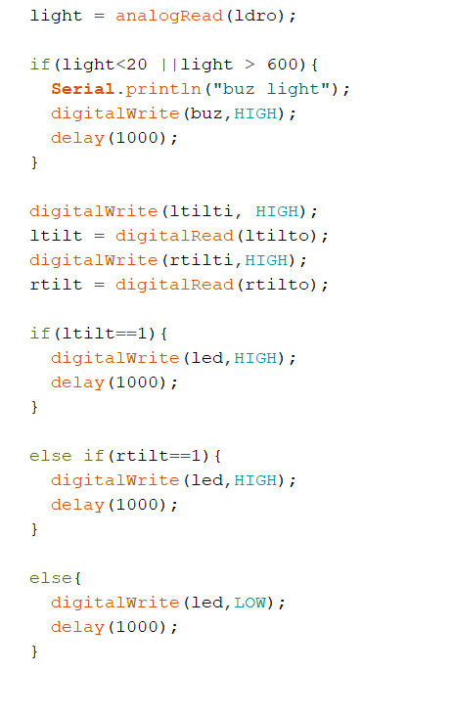
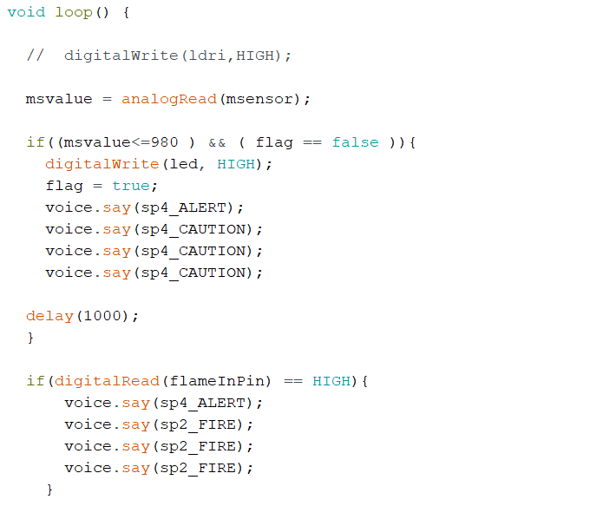

Slide 25

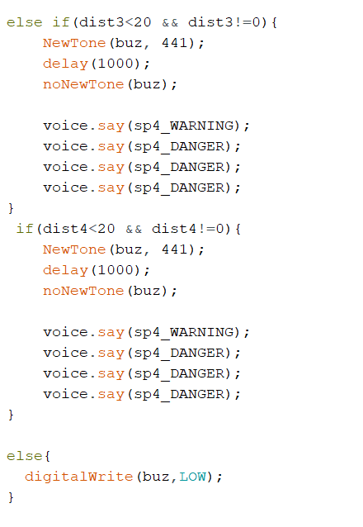

Slide 26
MODEL

Slide 27
COMPONENTS AND THEIR ALERTS:
FLAME SENSOR
USD
WATER SENSOR
FIRE
DANGER
ALERT

Slide 29
THANK YOU

